Slide 1

Place (Distribution)

Slide 2
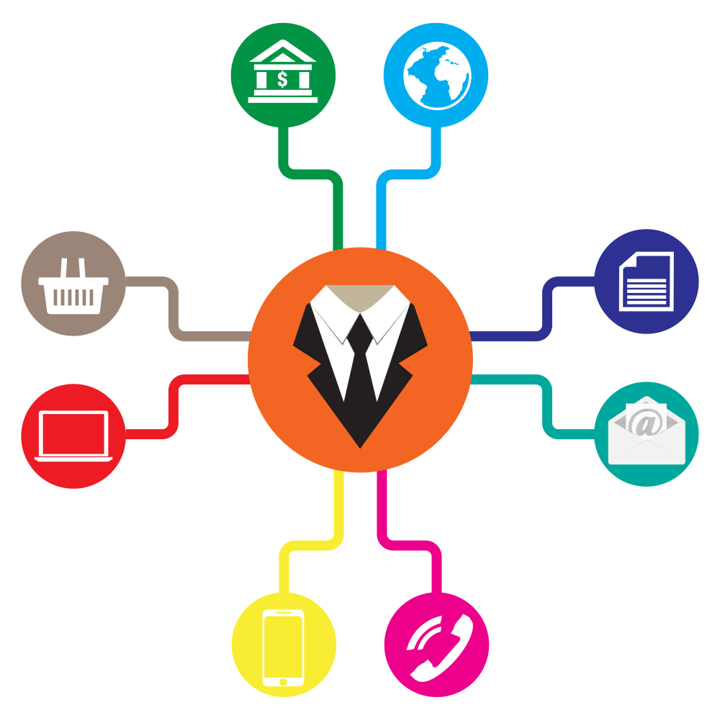
The Nature of Marketing Channels
Marketing Channel
  A channel of distribution is the combination of institutions through which a seller markets products to the user or ultimate consumer
Marketing Intermediary
  middleman linking producers to other middlemen or the ultimate consumer.
  (AMA, 2011)
Notes:
Copyright © 2000 by Houghton Mifflin Company. All rights reserved.
14-<number>

Slide 3
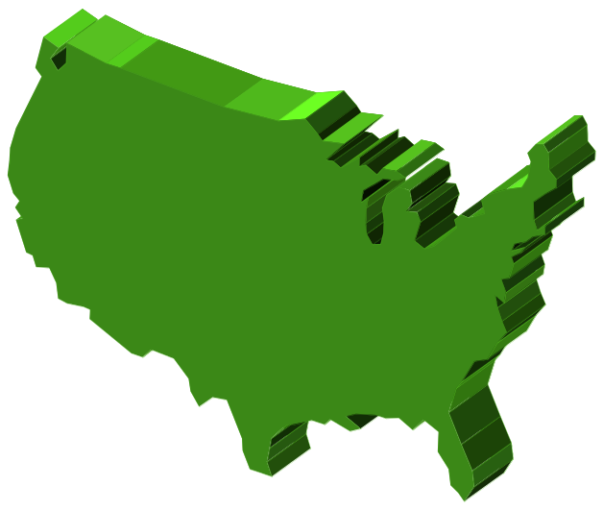
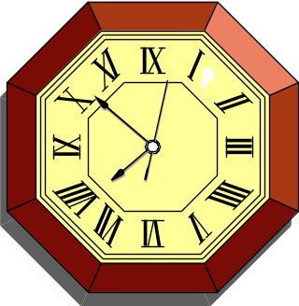

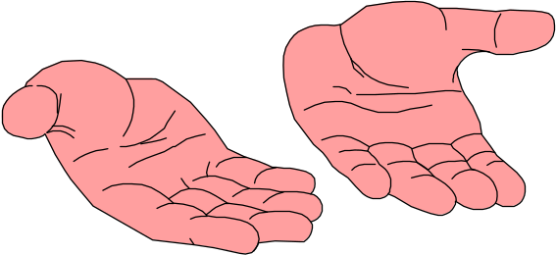
The Nature of Marketing Channels
Marketing Channels Create Utility
TIME
PLACE
POSSESSION
Notes:
Copyright © 2000 by Houghton Mifflin Company. All rights reserved.
14-<number>

Slide 4


Marketing Channel Activities Performed by Intermediaries
Marketing Information Analyse sales data and other information in databases and information systems. Perform or commission marketing research.
Marketing Management Establish strategic plans for developing customer relationships and organisational productivity.
Facilitating Exchanges Choose product assortments that match the needs of customers.
Cooperate with channel members to develop partnerships.
Promotion Set promotional objectives.
Coordinate advertising, personal selling, sales promotion, publicity, and packaging.
Price Establish pricing policies and terms of sales.
Physical Distribution Manage transportation, warehousing, materials handling, inventory control, and communication.
Notes:
Copyright © 2000 by Houghton Mifflin Company. All rights reserved.
14-<number>

Slide 5


The Nature of Marketing Channels
Key Tasks in Supply Chain Management
Planning Organisational and Systemwide Coordination of Marketing Channel Partnerships to Meet Customers’ Product Needs
Sourcing Purchasing of Necessary Resources, Goods, and Services from Suppliers to Support All Supply Chain Members
Facilitating Delivery All Activities Designed to Move the Product Through the Marketing Channel to the End User
Relationship Building All Marketing Activities Related to Selling, Service, and the Development of Long-Term Customer Relationships
(Kotler & Armstrong, 2012)
Notes:
Copyright © 2000 by Houghton Mifflin Company. All rights reserved.
14-<number>

Slide 6
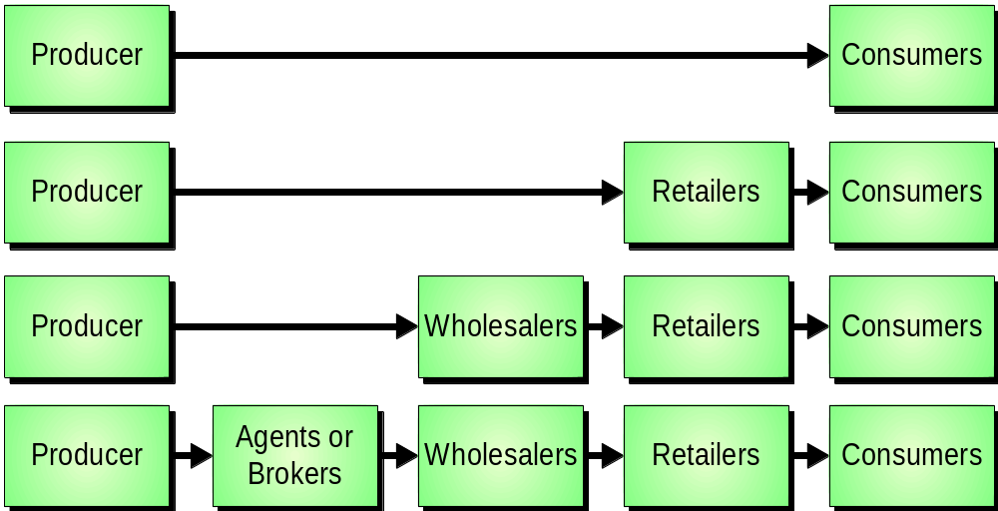
Types of Marketing Channels
Channels for Consumer Products
Notes:
Copyright © 2000 by Houghton Mifflin Company. All rights reserved.
14-<number>

Slide 7
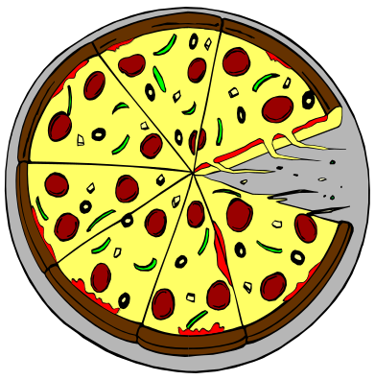

Intensity of Market Coverage
Selective
Distribution
Intensive
Distribution
Exclusive
Distribution
Notes:
Copyright © 2000 by Houghton Mifflin Company. All rights reserved.
14-<number>

Slide 8

Channel Considerations
Selecting a channel of distribution can hinge on one of these factors:
Distribution coverage required
Degree of control desired
Total distribution cost
Channel flexibility
(Kenton, 2020)

Slide 9
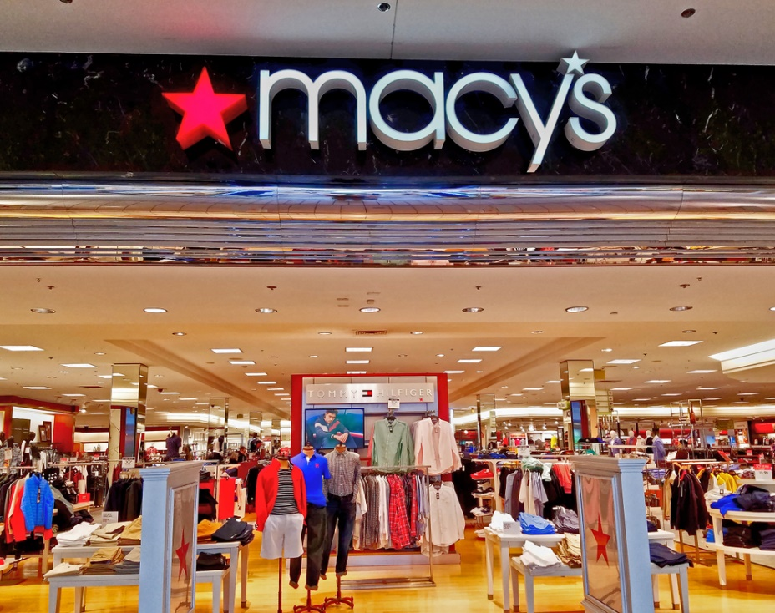
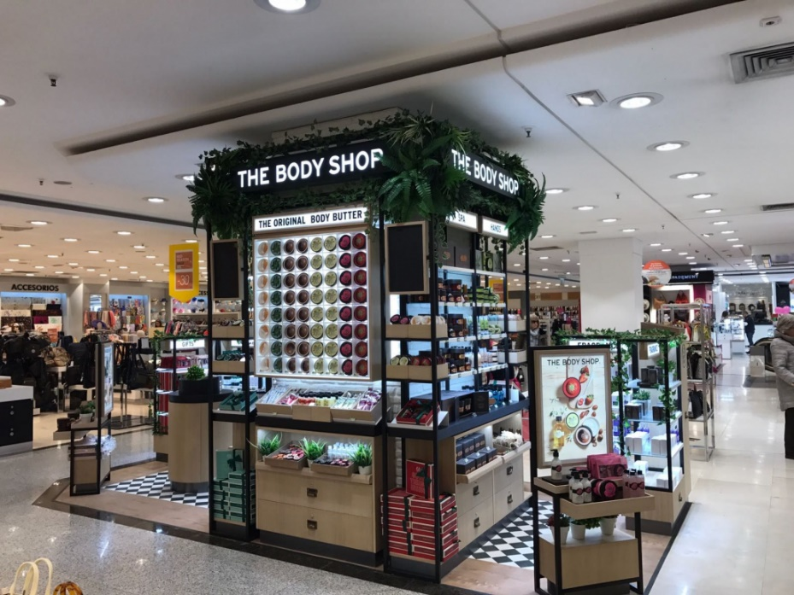
Store Retailing
Mass merchandisers carry a broad assortment of goods and compete based on selection and price
Specialty stores handle deep assortments in a limited number of product categories
Convenience stores are retailers whose primary advantage is location
(Pride & Ferrel, 2018)

Slide 10

Nonstore Retailing
Catalogues
Direct mail
Vending machines
Television home shopping
Direct sales
E-commerce / M-commerce
(Forbes, 2014)

